Slide 1
数学预备知识

Slide 2
A.7.1 求和的积分近似

Slide 5
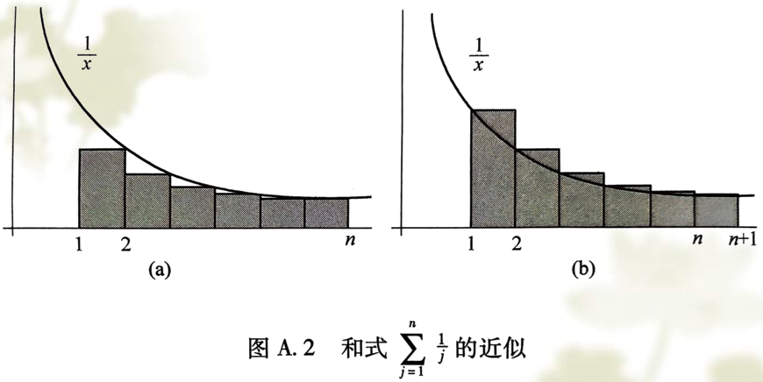

Slide 6
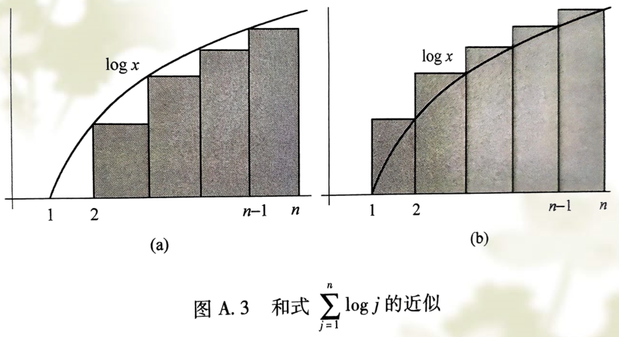

Slide 7
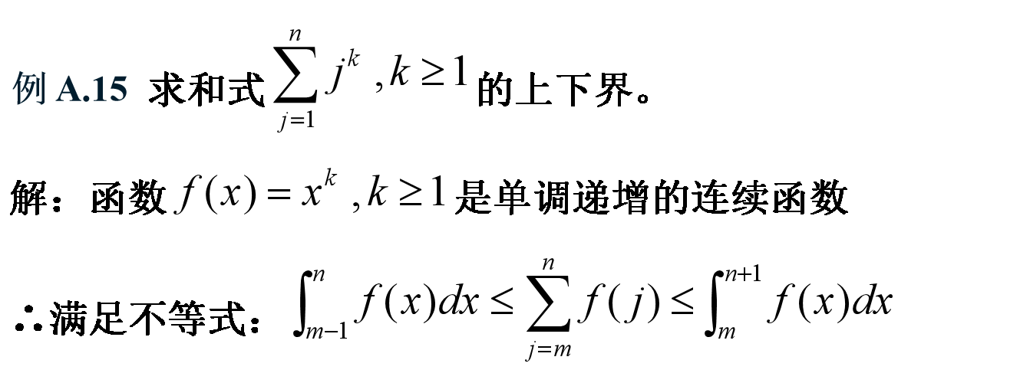
？？？

Slide 9
1
2

Slide 10
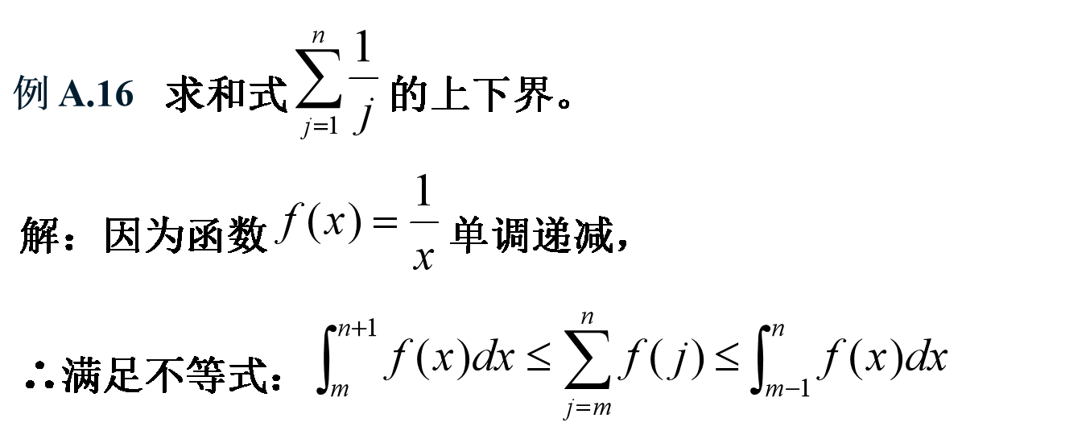


Slide 11


Slide 12
1

Slide 13
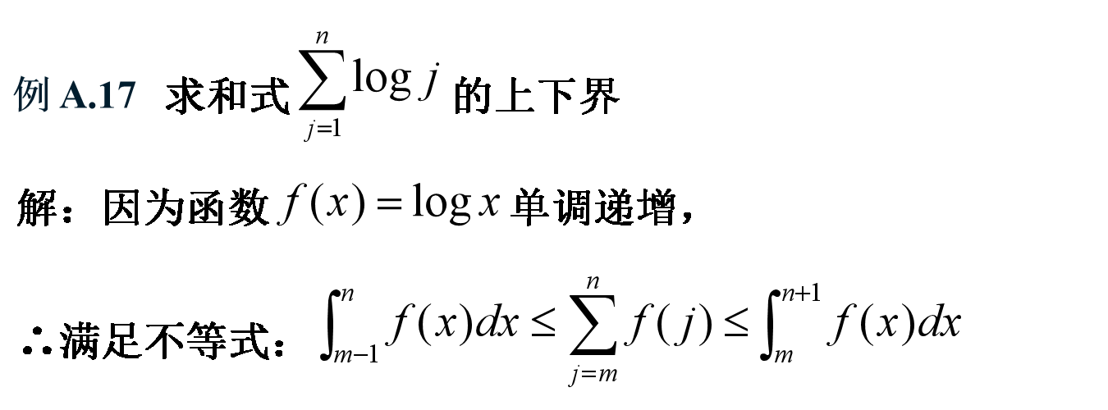


Slide 15
2

Slide 17
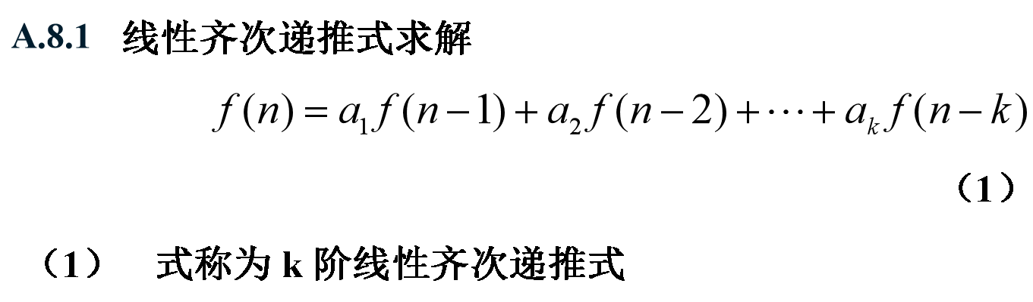

Slide 21
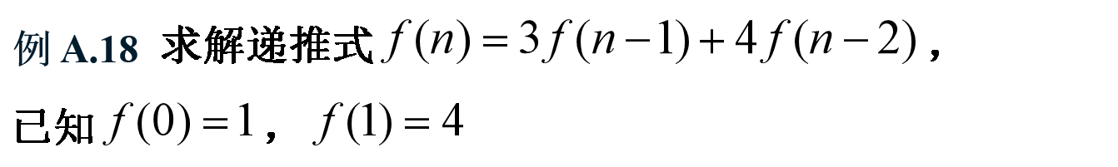

Slide 22
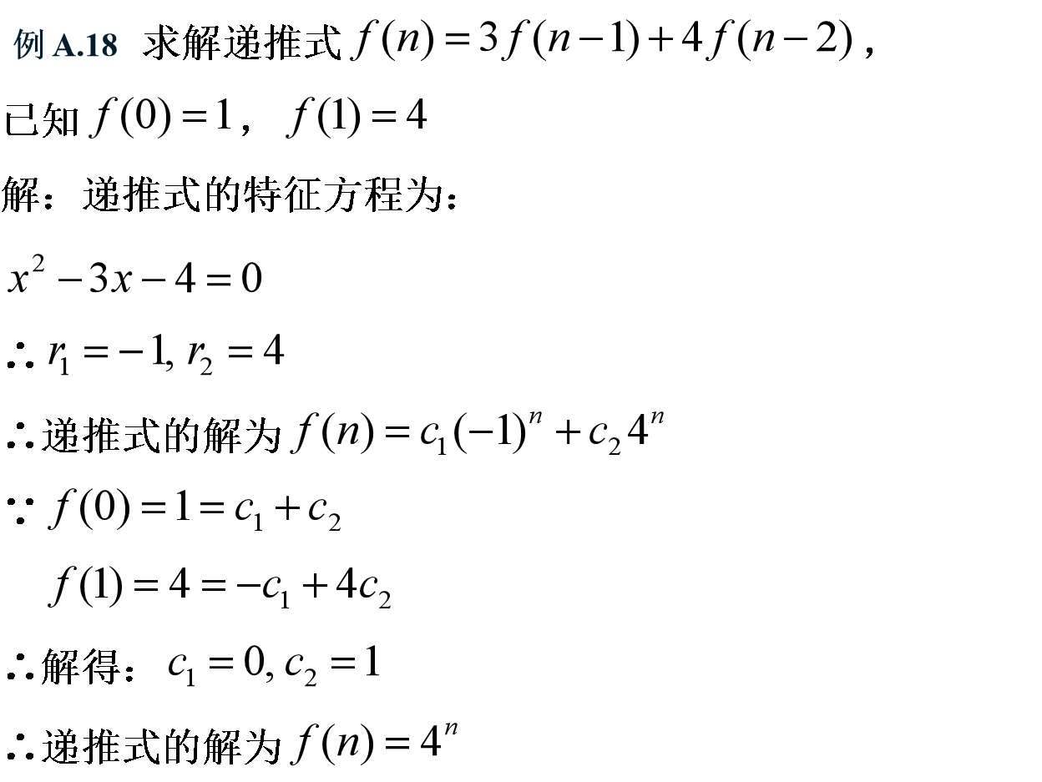

Slide 23
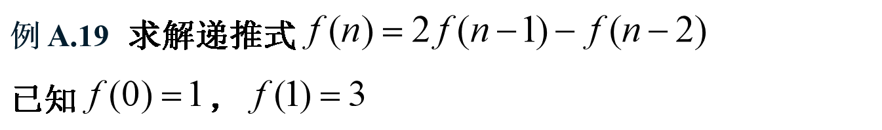

Slide 24
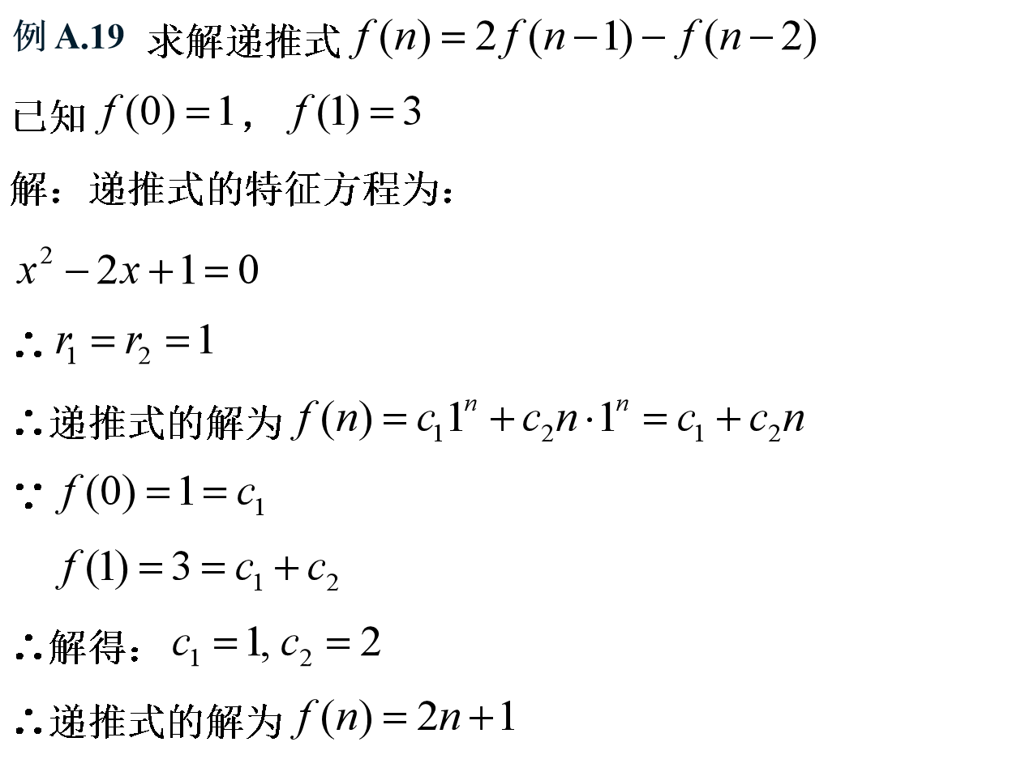

Slide 25
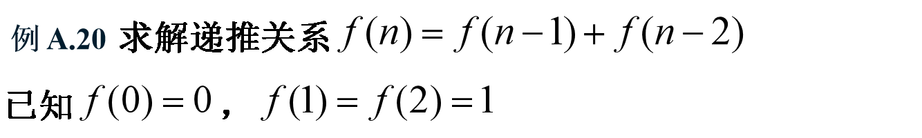

Slide 26
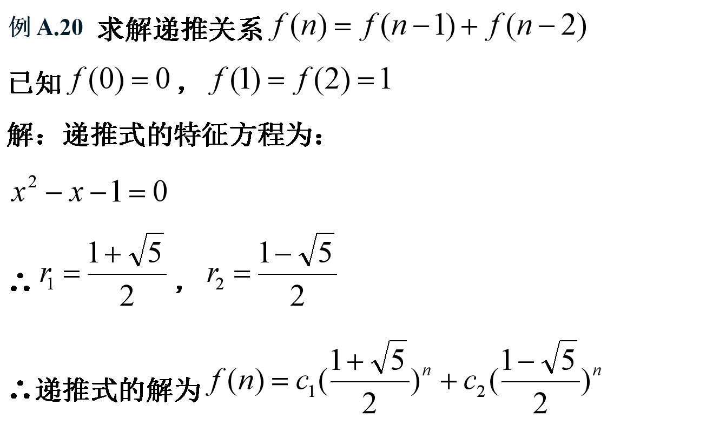

Slide 28
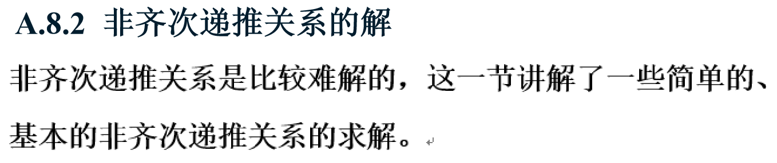

Slide 30
1
2

Slide 32
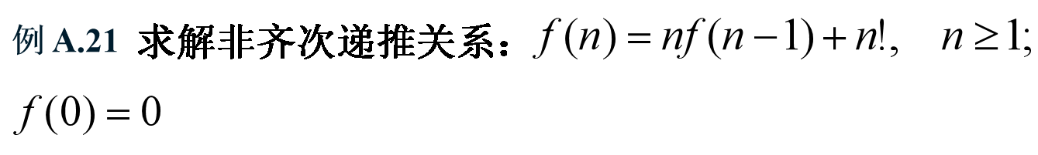

Slide 33
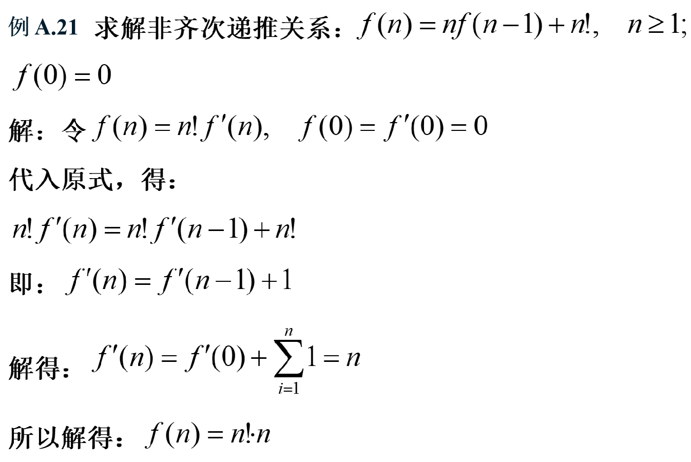

Slide 34
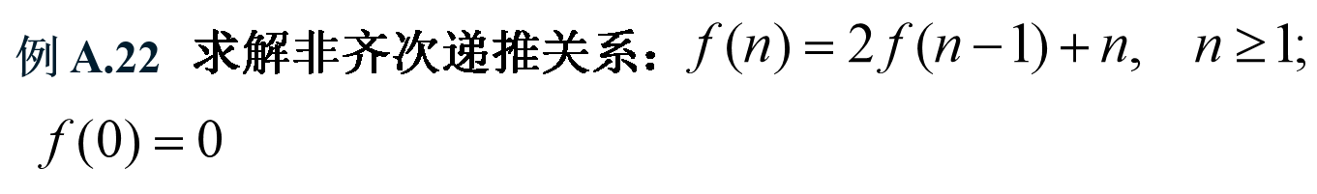

Slide 35


Slide 38
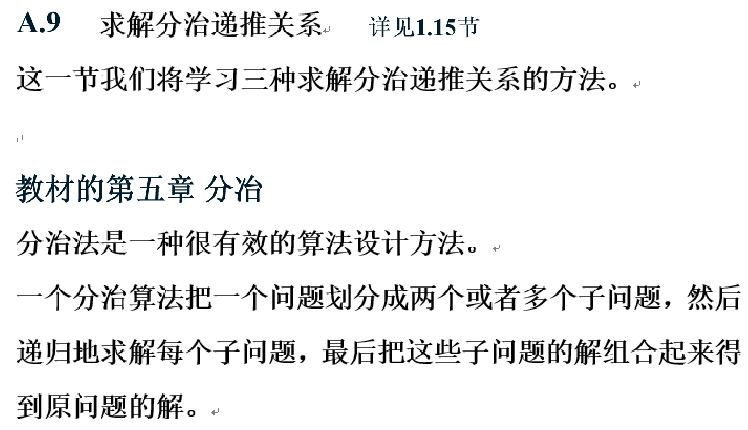

Slide 39


Slide 40
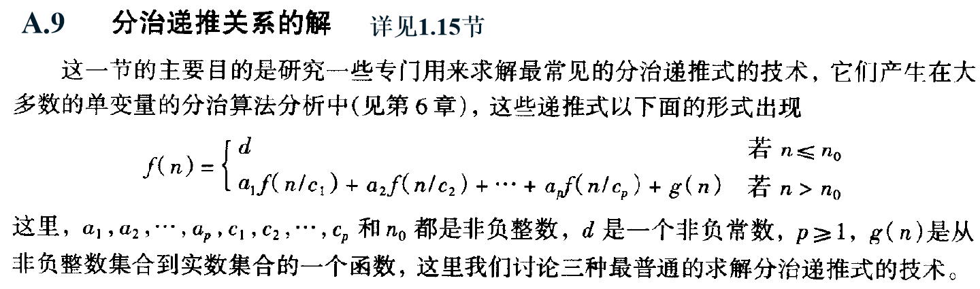

Slide 41
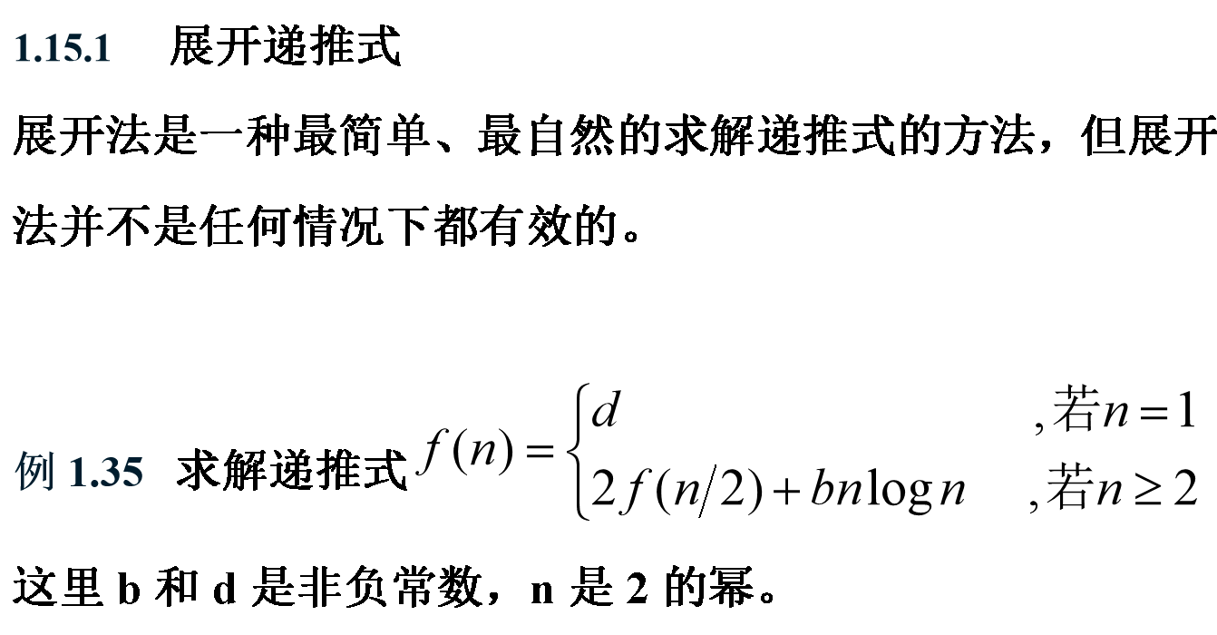

Slide 42
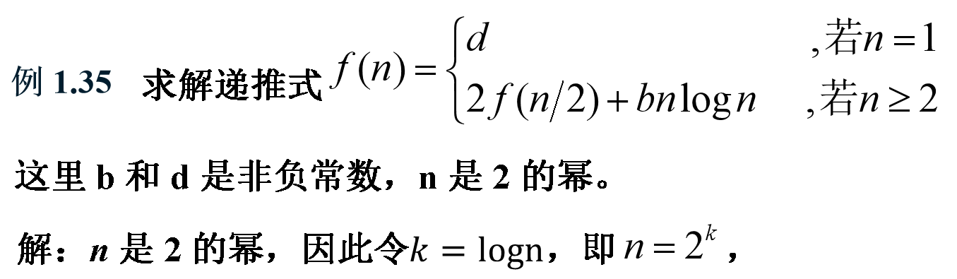
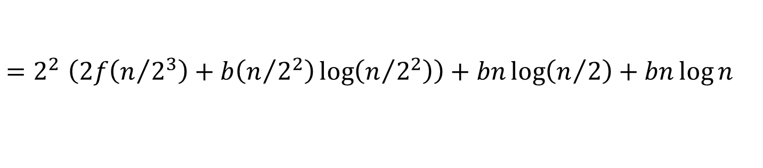
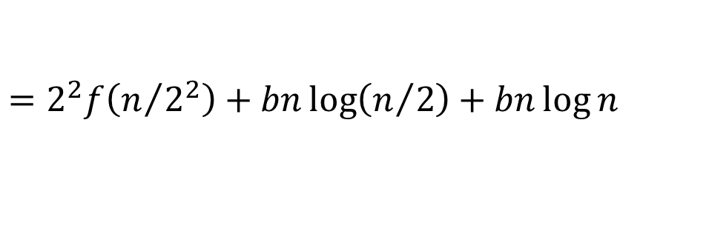
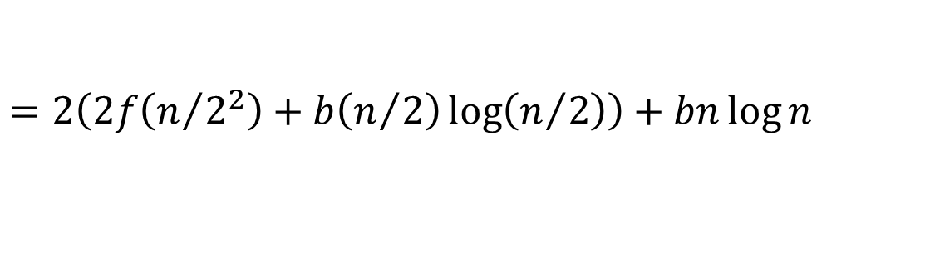

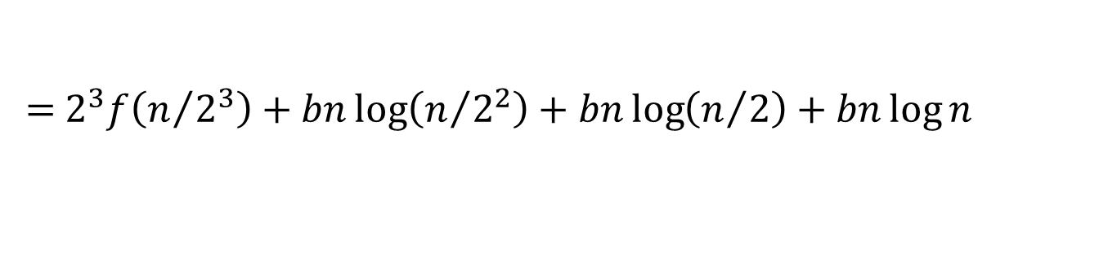
$$f\left(n\right)=2f\left(n/2\right)+bn\log{n}$$
$$=2\left(2f\left(n/{2^{2}}\right)+b\left(n/2\right)\log\left(n/2\right)\right)+bn\log{n}$$
$$=2^{2}f\left(n/{2^{2}}\right)+bn\log\left(n/2\right)+bn\log{n}$$
$=2^{2}$ $\left(2f\left(n/{2^{3}}\right)+b\left(n/{2^{2}}\right)\log\left(n/{2^{2}}\right)\right)+bn\log\left(n/2\right)+bn\log{n}$
= $2^{3}f\left(n/{2^{3}}\right)+bn\log\left(n/{2^{2}}\right)+bn\log\left(n/2\right)+bn\log{n}$
.
.
.
=${ 2}^{k}f\left(n/{2^{k}}\right)+bn\left(\log\left(n/{2^{k−1}}\right)+\log\left(n/{2^{k−2}}\right)+···+\log\left(n/{2^{0}}\right)\right)$

Slide 43
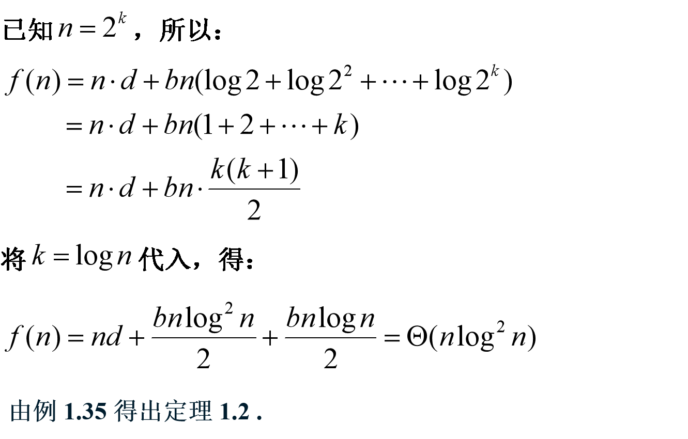

Slide 44
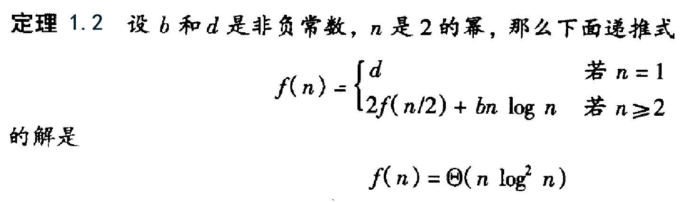

Slide 45
用展开法证明定理 1.3
引理1.1 、推论 1.1、 推论1.2

Slide 46
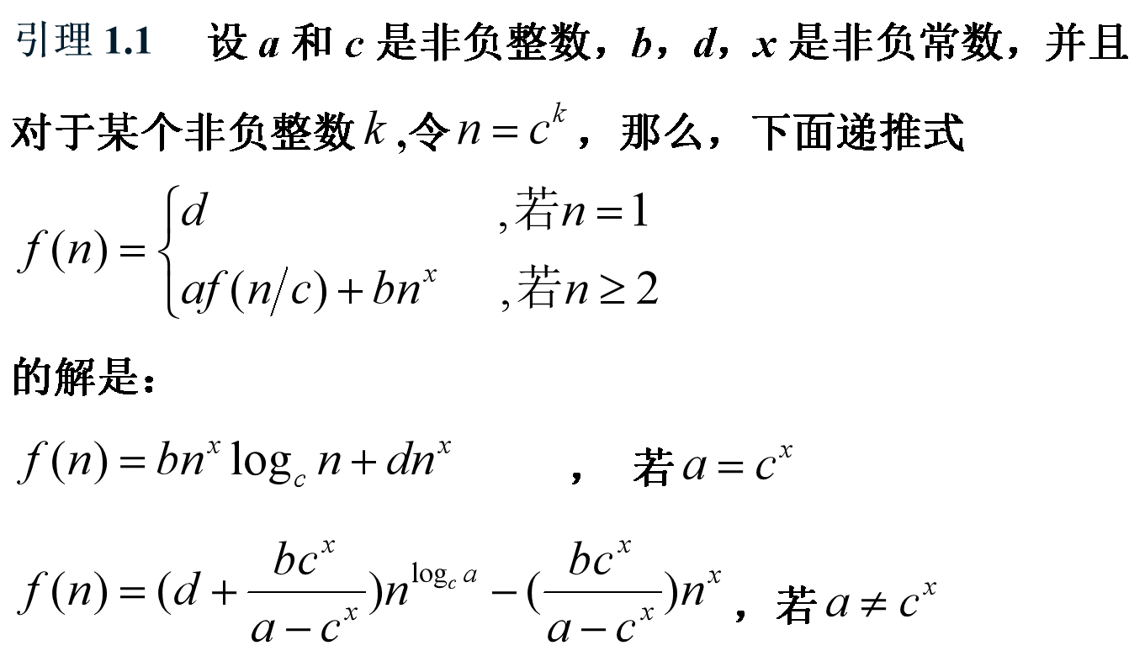
证明：用展开法来求解这个递推式如下

Slide 47
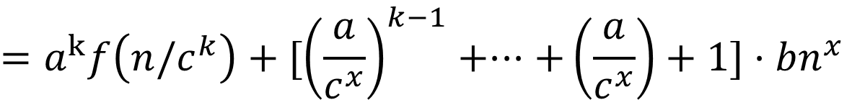


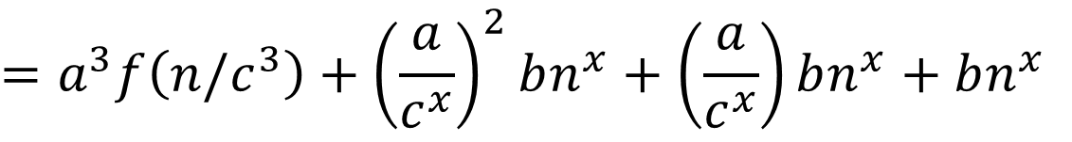
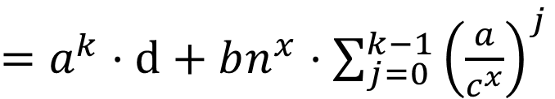
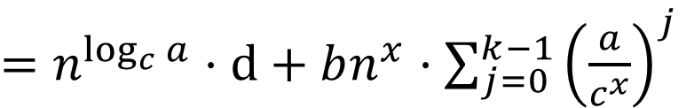
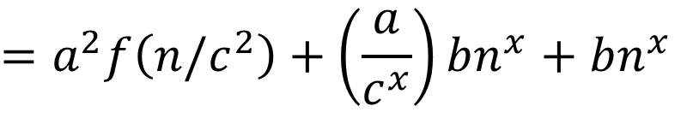
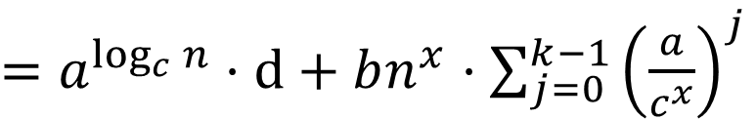
$$f\left(n\right)=af(n/c)+bn^{x}$$
$$=a\left(af\left(n/c^{2} \right)+b{(n/c)}^{x}\right)+bn^{x}$$
$$=a^{2}f\left(n/c^{2}\right)+\left(\frac{a}{c^{x}}\right)bn^{x}+bn^{x}$$
$=$ $a^{2}\left(af\left(n/c^{3} \right)+b{(n/c^{2})}^{x}\right)+\left(\frac{a}{c^{x}}\right)bn^{x}+bn^{x}$
$$=a^{3}f\left(n/c^{3}\right)+{\left(\frac{a}{c^{x}}\right)}^{2}bn^{x}+\left(\frac{a}{c^{x}}\right)bn^{x}+bn^{x}$$
$$·$$
·
·
$$=a^{k}f\left(n/c^{k}\right)+[{\left(\frac{a}{c^{x}}\right)}^{k−1}+···+\left(\frac{a}{c^{x}}\right)+1]·bn^{x}$$
$=$ $a^{k}·d+bn^{x}·\sum_{j=0}^{k−1}{{\left(\frac{a}{c^{x}}\right)}^{j}}$
$=$ $a^{\log_{c}{n}}·d+bn^{x}·\sum_{j=0}^{k−1}{{\left(\frac{a}{c^{x}}\right)}^{j}}$
$=$ $n^{\log_{c}{a}}·d+bn^{x}·\sum_{j=0}^{k−1}{{\left(\frac{a}{c^{x}}\right)}^{j}}$

Slide 49
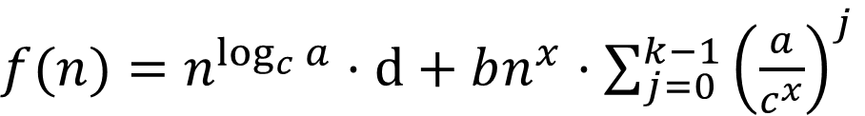
根据前面解得的结果：
$f(n)=$ $n^{\log_{c}{a}}·d+bn^{x}·\sum_{j=0}^{k−1}{{\left(\frac{a}{c^{x}}\right)}^{j}}$

Slide 51
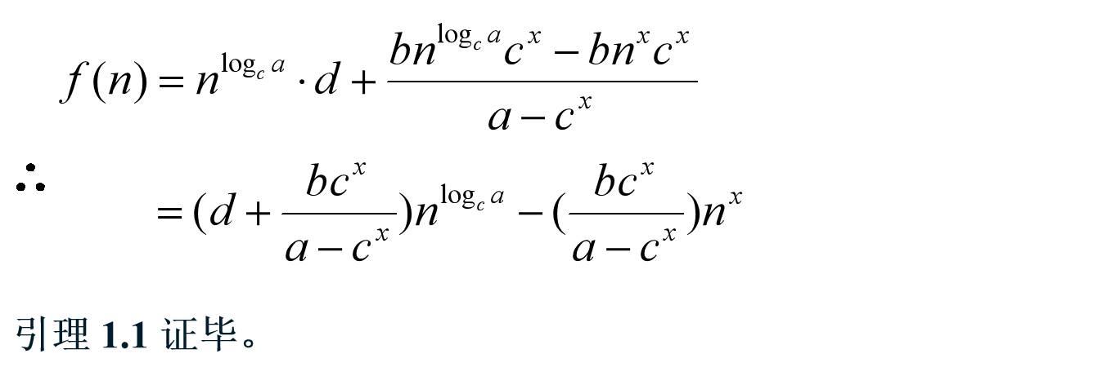
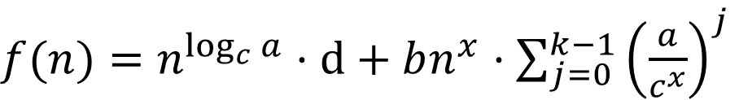
根据前面解得的结果：
$f(n)=$ $n^{\log_{c}{a}}·d+bn^{x}·\sum_{j=0}^{k−1}{{\left(\frac{a}{c^{x}}\right)}^{j}}$

Slide 52
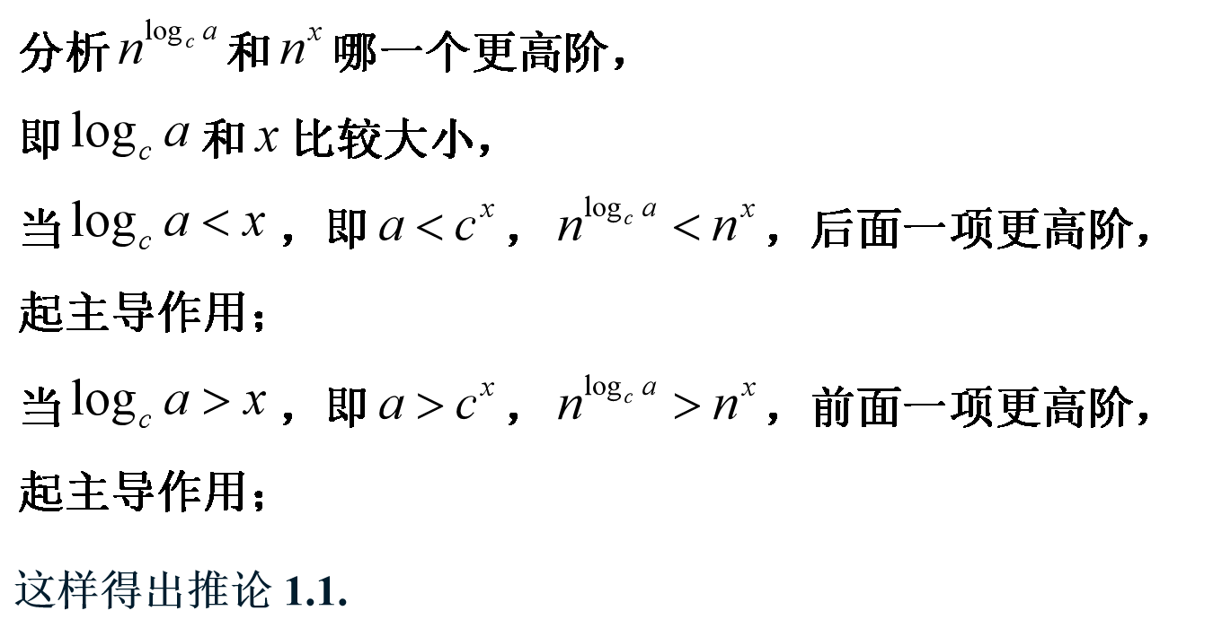

Slide 53
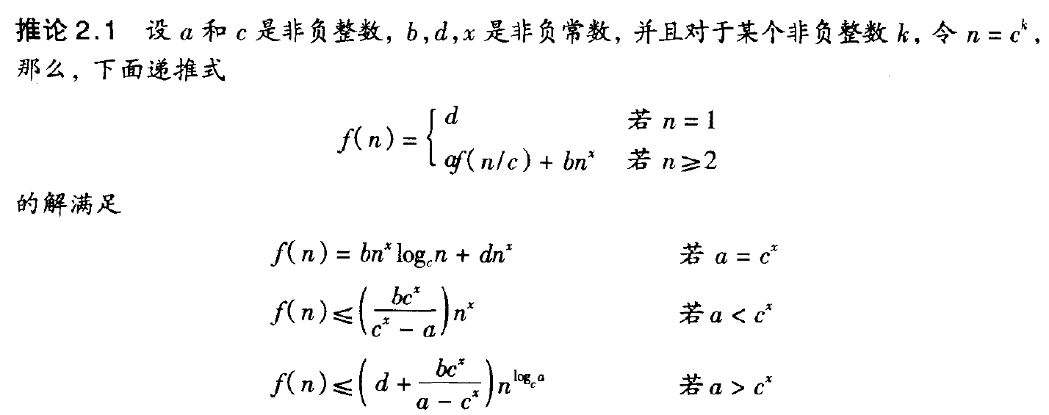


Slide 55
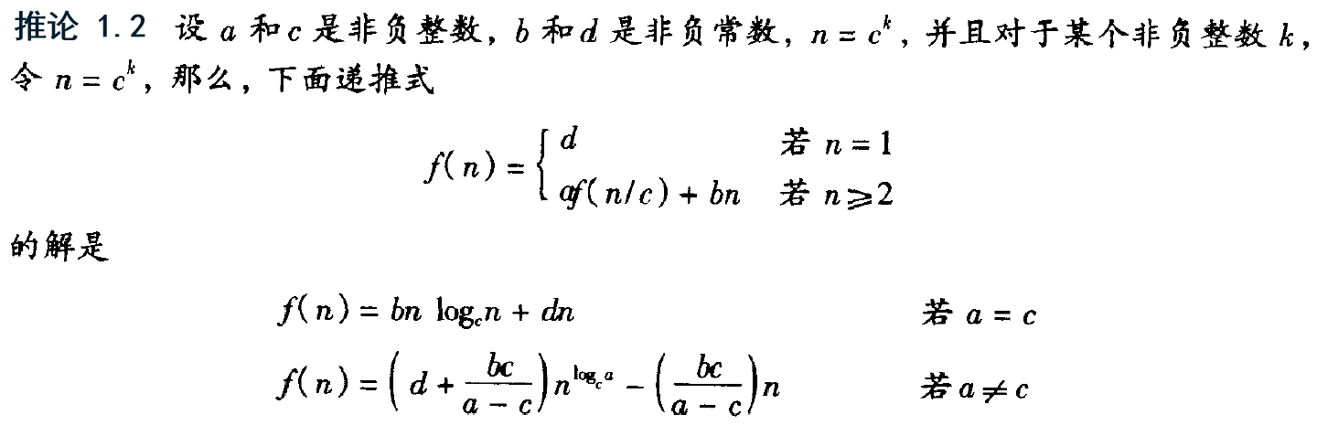

Slide 56
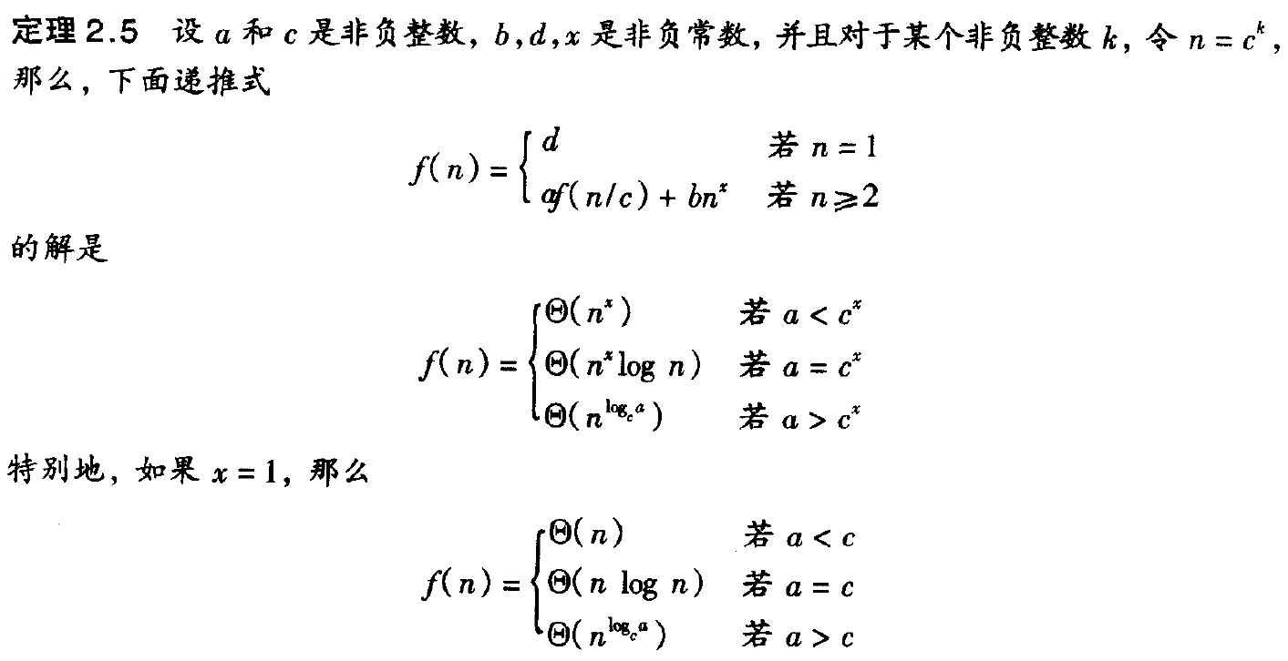

定理 1.3

Slide 59




代入：
$$f\left(n\right)=f\left(⌊n/2⌋\right)+f\left(⌈n/2⌉\right)+bn$$
$$≤cb\left\lfloor n/2\right\rfloor \log\left\lfloor n/2\right\rfloor +d\left\lfloor n/2\right\rfloor +cb\left\lceil n/2\right\rceil \log\left\lceil n/2\right\rceil +d\left\lceil n/2\right\rceil +bn$$
$$≤cb\left\lfloor n/2\right\rfloor log\left\lceil n/2\right\rceil{+cb\left\lceil n/2\right\rceil \log\left\lceil n/2\right\rceil +dn+bn}$$
$$=cbnlog\left\lceil n/2\right\rceil +dn+bn$$
$$≤cbn\log{((n+1)/2)+dn+bn}$$
$$=cbnlog\left(n+1\right)−cbn+dn+bn$$
$$令f\left(n\right)≤cbnlog\left(n+1\right)−cbn+dn+bn≤cbn\log{n+dn}$$

Slide 62



$$f\left(n\right)=f\left(⌊n/2⌋\right)+f\left(⌈n/2⌉\right)+bn$$
$$≥cb\left\lfloor n/2\right\rfloor \log\left\lfloor n/2\right\rfloor +d\left\lfloor n/2\right\rfloor +cb\left\lceil n/2\right\rceil \log\left\lceil n/2\right\rceil +d\left\lceil n/2\right\rceil +bn$$
$$≥cb\left\lfloor n/2\right\rfloor log\left\lfloor n/2\right\rfloor{+cb\left\lceil n/2\right\rceil \log\left\lfloor n/2\right\rfloor +dn+bn}$$
$$=cbnlog\left\lfloor n/2\right\rfloor +dn+bn$$
$$≥cbn\log{(n/4)+dn+bn}$$
$$=cbnlogn−2cbn+dn+bn$$

Slide 64

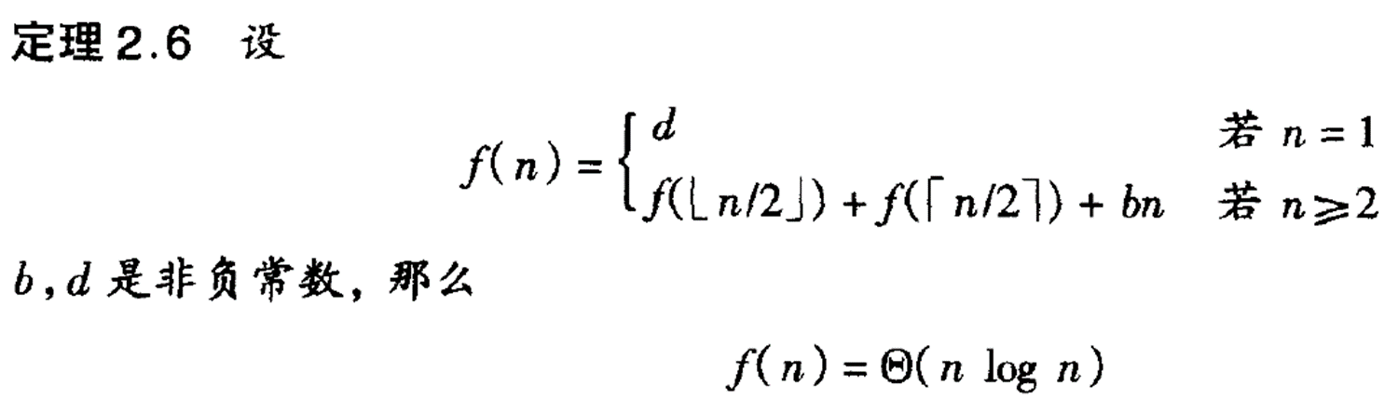

Slide 68
？？？
1

Slide 69
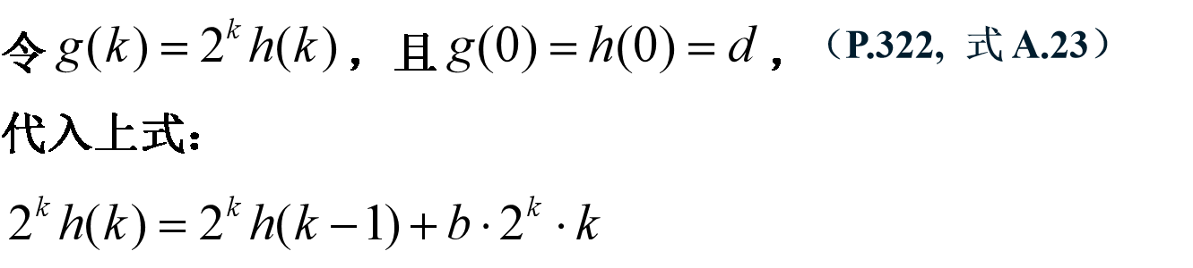

Slide 71
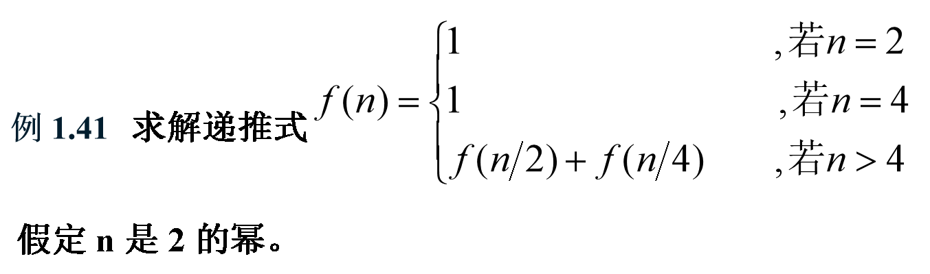

Slide 72
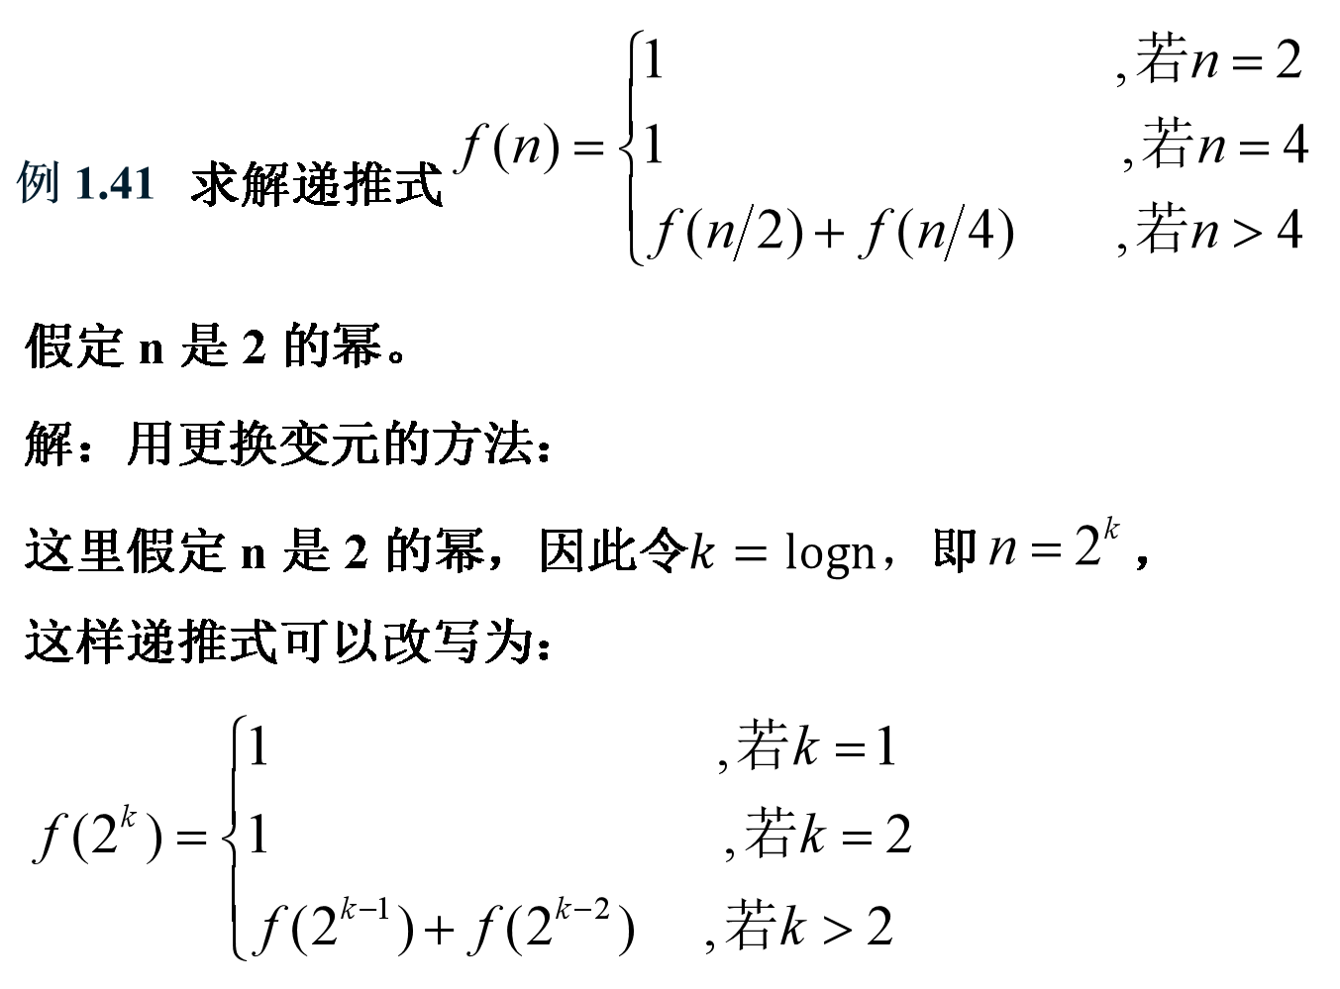

Slide 73


Slide 74
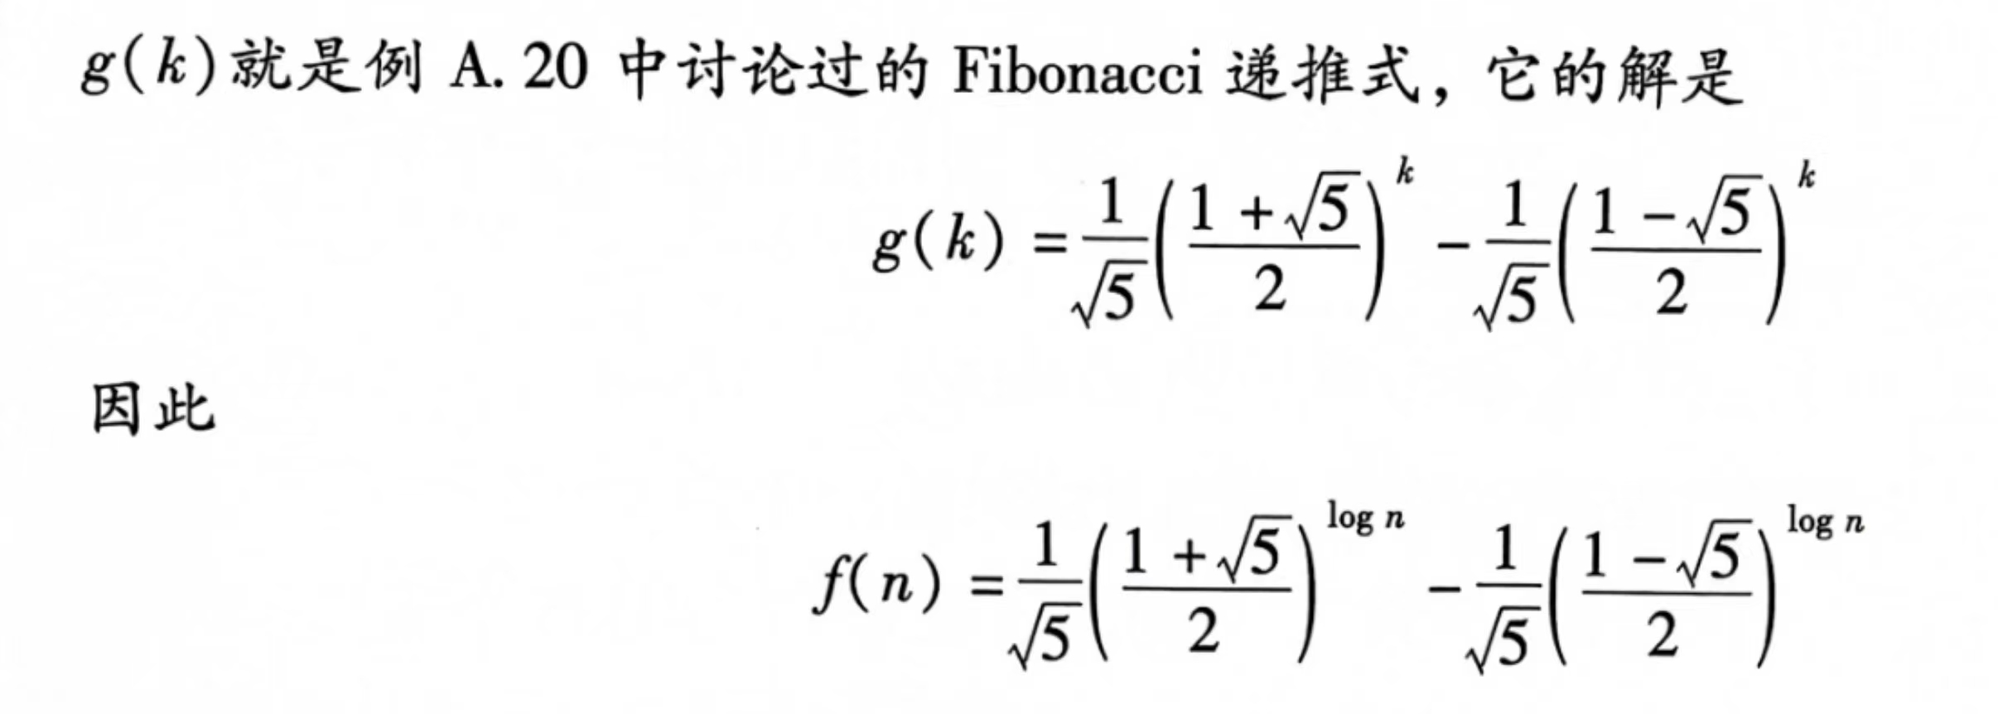

Slide 75
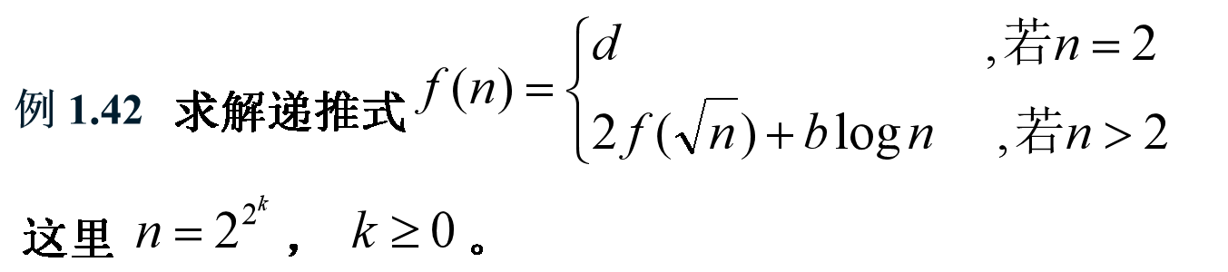

Slide 76
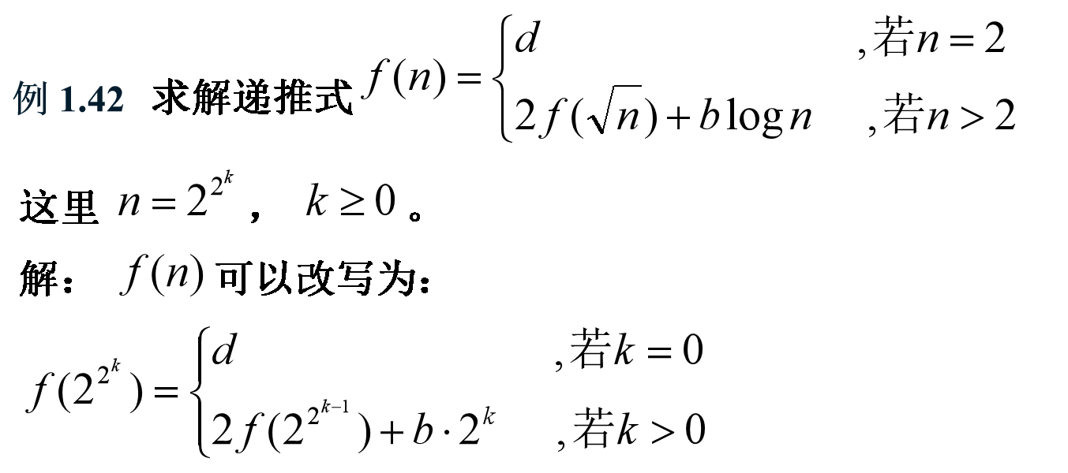

Slide 77

2
Notes:
1

Slide 78
